Slide 1
Calculating Location Quotients
September 14, 2012

Slide 2
Agenda
Basic Concepts
What are location quotients?
How do I calculate location quotients?
How do I interpret location quotients
Examples
Using the BLS LQ Calculator
Questions

Slide 3
Basic Economic Model
Export or ‘base’ activity (new $s)
Non-basic activity (recycled $s)
Examples:
Manufacturing
Tourism
Some hospitals
Regional shopping malls
Social Security income
Examples:
Auto repair services
Small convenience retail
Outpatient medical
Personal services like barber shops
Print and copy shops

Slide 4
North American Industry Classification System (NAICS)
NAICS level | Example #1 |  | Example #2
 | NAICS code | Description | NAICS code | Description
Sector | 31-33 | Manufacturing | 51 | Information
Subsector | 311 | Food Manufacturing | 513 | Broadcasting and telecommunications
Industry group | 3115 | Dairy Product Manufacturing | 5133 | Telecommunications
Industry | 31151 | Dairy Product (except Frozen) Manufacturing | 51332 | Wireless telecommunications carriers, except satellite
U.S. Industry | 311513 | Cheese Manufacturing | 513321 | Paging
Unique to country; standardization ends at 5-digit code.

Slide 5
Location Quotients (LQs) are a regularly used method for regional analysis
LQs measure the relative concentration of a given industry in a given place.
  Often relative to the nation, but can also calculate state LQs
LQs are used to identify potential sources of competitive advantage, or areas of regional specialization
Calculated by dividing the proportion of the region’s economic activity in an industry, by the proportion of the nation’s economic activity in that same industry.
Industry employment is the most commonly used variable, but could also generate LQs from other variables.
  E.g., occupational employment, industrial output, revenue, etc.

Slide 6
Location Quotients
Formula
Example
LQ
Region
Region
20 MFG jobs
5 MFG jobs
10 MFG jobs
Industry
Total
100 Total Jobs
0.5
2
1
Nation
Nation
Industry
100,000 MFG Jobs
Total
1,000,000 Total Jobs
Notes:
LQ – presence not advantage, no info on linkages, no distinction btw large and small firms
Need to consider some sort of trend information

Slide 7
Interpreting LQs
Can use location quotient to get a sense of the specialization of regional industries
  General rules of thumb
    LQs of 1.2 or higher indicates some degree of specialization
    LQs of 0.8 to 1.2 indicate normal distribution of industry within the region
    LQs of less than 0.8 may indicate that the region may be deficient
  Depends on size of region, nature of industry
    Smaller regions may have larger LQs
    Not industries are appropriate for all places
If all location quotients near or at a 1.0, will see the region resembling the national economy
  Region may be sufficiently diversified

Slide 8
Thinking about LQs
Sensitive to the size of the region and base
Sensitive to the level of industry
Industry | Alabama | Montgomery County
NAICS 31-33 Manufacturing | 1.51 | 1.26
NAICS 336 Transportation Eqpt. MFG | 2.55 | 3.51
NAICS 3363 Motor Vehicle Parts MFG | 2.47 | 1.21
NAICS 54 Professional and technical services | 0.91 | 1.00
NAICS 5412 Accounting and bookkeeping services | 0.78 | 1.17
NAICS 541213 Tax preparation services | 0.86 | 0.50

Slide 9
Interpreting Location Quotients
Interpretation
High is not always good, low is not always bad
Its best not to interpret LQs in a vacuum
Change in LQ is another important consideration
Source: J. Paytas
Notes:
LQ – presence not advantage, no info on linkages, no distinction btw large and small firms
Need to consider some sort of trend information

Slide 10
Change in LQ
Industry in Madison County, AL (Huntsville) | 2008 | 2011
NAICS 31-33 Manufacturing | 1.59 | 1.34
NAICS 336 Transportation Equipment MFG | 4.06 | 3.45
NAICS 3364 Aerospace Product and Parts MFG | 7.30 | 6.77
During this time period:
  Manufacturing employment lost about 7,500 jobs
  Transportation Eqpt MFG lost about 2,300 jobs
  Aerospace MFG lost about 500 jobs

Slide 11
Examples:
Example #1: Alabama sectors
Example #2: Alabama occupations

Slide 12
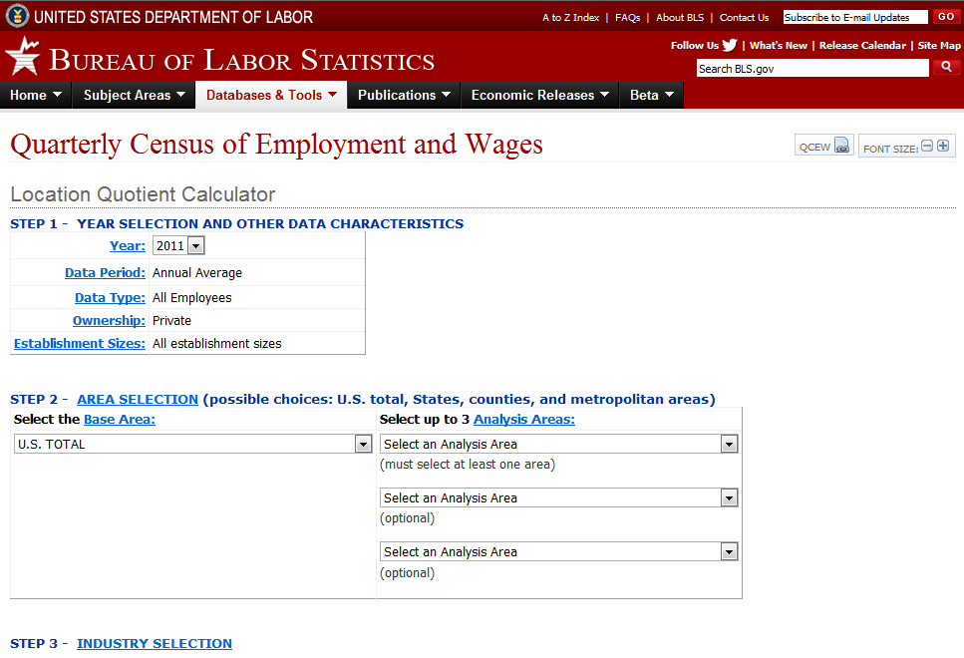
BLS Location Quotient Calculator
(http://www.bls.gov/cew/cewlq.htm)

Slide 13
Questions?

